Slide 1

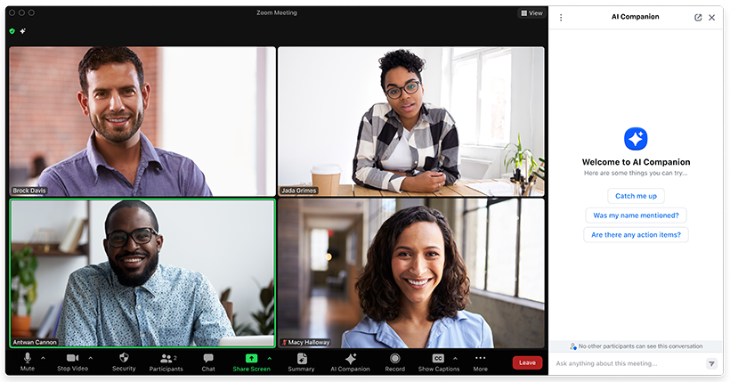

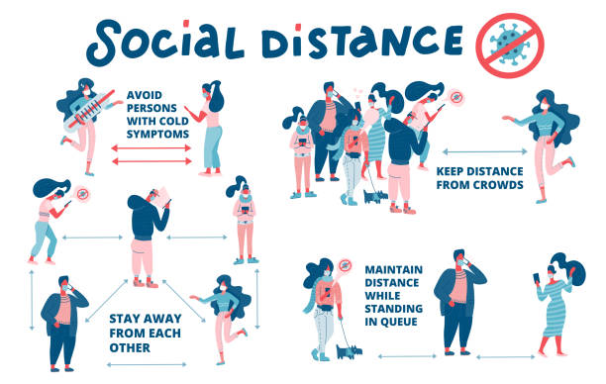

Slide 2


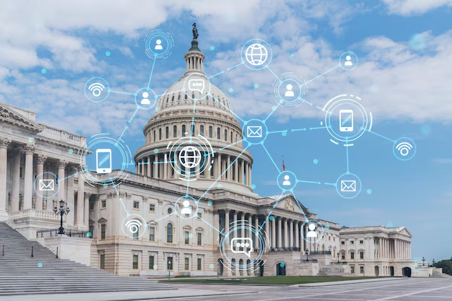

TECHNOLOGY & THE U.S. GOVERNMENT
Amber Vergara
CSIT 100-04

Slide 3

Overview
Benefits & Risks of Advanced Technology
Technology in Decision-Making and Policy
Future Directions and Recommendations

Slide 4


Background: Tech in Government Work
Manual task automation
Process automation
Automated decision-making
Integrated data systems
Electronic monitoring
01
02
03
04
05

Slide 5
Benefits: Efficiency
Automation improves speed + accuracy (e-filing, online benefit applications)
Integrated data systems improve customer experience (Alaska DHSS call center)
Expanded access to information during crises (pandemic response)
Reduced paperwork and in-person processing
Greater accessibility for citizens

Slide 6
Benefits: Innovation & Economy
Federal policies which support innovation (Bayh-Dole Act; Federal Technology Transfer Act)
Funding for research labs → new technologies + productivity
National Research Cloud proposal → expanded access to AI tools for researchers

Slide 7
Risks: Workforce Strain
Public sector underfunding + staffing shortages
New technological policies + already overwhelmed workers = conflict
Limited capacity to test, adjust, and maintain new systems

Slide 8
Risks: Ethical & Institutional Failures
2023 Case study: UnitedHealth AI claim denials
System had a 90% error rate, still relied on by company
Patients forced to pay or abandon treatment
Shows how misuse of technology can erode public trust
Assassination of UHC CEO Brian Thompson in 2024
Illustrates risk of replacing human judgment with flawed AI

Slide 9
Machine Learning
In Weather
AI + machine learning improve forecasting and analysis
Example: GAO’s use of AI to improve severe weather predictions
Benefits: faster forecasts, more accurate models, save lives & property
In Policy
Machine learning predicts outcomes based on past cases (legal field)
Enhances productivity but does not replace the final human decision
Some roles shrink (translation), others expand (law, policymaking)
Balance is Key!

Slide 10
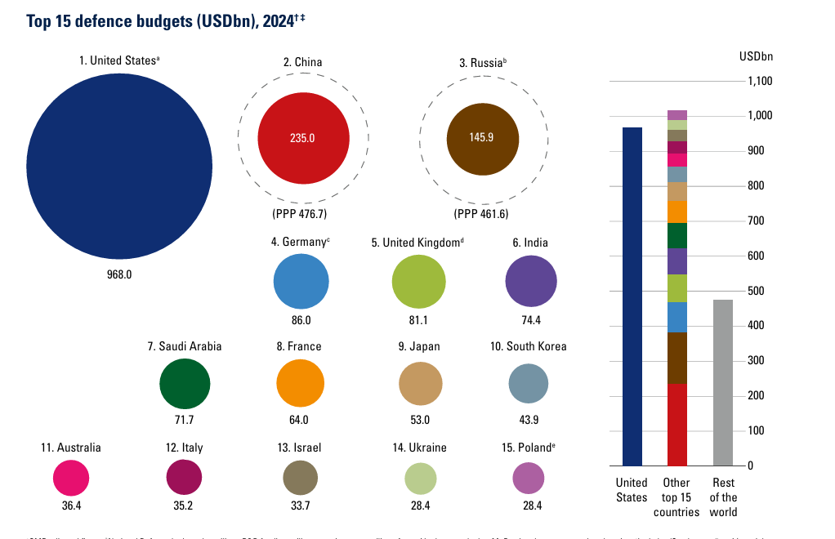
Government Challenges
Billions lost to improper calculations since 2003 (GAO)
Human error unavoidable; improved tech could reduce losses
Defense vs. domestic investment imbalance
$968B defense budget (2024)
Policy choices reflect political priorities, not always citizens’ needs

Slide 11
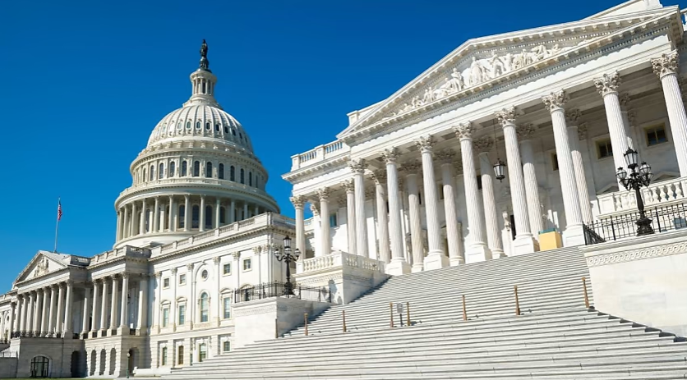

Suggested: Changes in Policy
Strengthen & modernize infrastructure
Increase funding + staffing for public sector workers
Implement federal AI ethics + transparency standards
Maintain human oversight in AI decision-making
Promote tech that supports, not replaces, public service goals

Slide 12


Conclusion
Technology is essential, but must be handled responsibly
Human oversight, transparency, and accountability are non-negotiable
Technology should serve people, not the other way around

Slide 13
Sources
Agrawal, A., Gans, J. S., & Goldfarb, A. (2019). Artificial Intelligence: The Ambiguous Labor Market Impact of Automating Prediction. The Journal of Economic Perspectives, 33(2), 31–50. https://www.jstor.org/stable/26621238
Bothwell, B. (Host), (2023, December 14). Artificial Intelligence in Severe Weather and Wildfire Modeling. GAO Watchdog Report. Government Accountability Office. https://www.gao.gov/podcast/artificial-intelligence-severe-weather-and-wildfire-modeling
Chenok, Dan. “2025 How Technology Can Drive Government Efficiency.” IBM Center for The Business of Government, 2025, www.businessofgovernment.org/sites/default/files/How TECHNOLOGY Can Drive GOVERNMENT EFFICIENCY_0.pdf.
Hinkley, Sara. 2022. Technology in the Public Sector and the Future of Government Work. Berkeley:
UC Berkeley Labor Center. https://laborcenter.berkeley.edu/technology-in-the-public-sector
and-the-future-of-government-work/
International Institute for Strategic Studies. (2025). Defence and military analysis. The Military Balance 2025 by The International Institute for Strategic Studies (IISS) | 9781040379745. https://www.iiss.org/globalassets/media-library---content--migration/files/publications/military-balance/2025-military-balance/the-military-balance-2025_defence-spending-and-procurement-trends.pdf
Rasser, M., & Lamberth, M. (2021). How the United States Competed: Past Technology Strategies. In Taking the Helm: A National Technology Strategy to Meet the China Challenge (pp. 14–20). Center for a New American Security. http://www.jstor.org/stable/resrep28655.7
The Estate of Gene B. Lokken, et al. v. UnitedHealth Group, Inc., et al., No. 0:23-cv-03514 (D. Minn. Nov. 14, 2023).
https://www.classaction.org/media/the-estate-of-gene-b-lokken-et-al-v-unitedhealth-group-inc-et-al.pdf

Slide 14


Thank You

